Slide 1
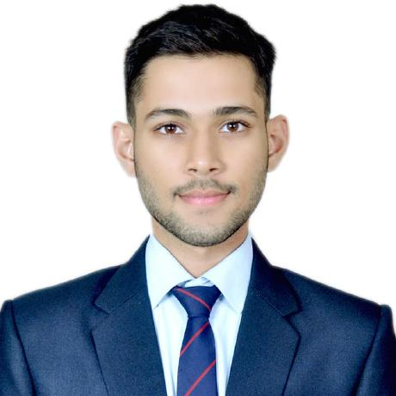
Bhavik Mundra
I am a final year Computer Science undergraduate student from AITR, Indore.

Slide 2
ACADEMIC RECORDS
Professional qualifications – 2020-2024
B. Tech Computer Science & Engineering
AITR, Indore
CGPA 8.01.
Educational Qualifications
Senior Secondary Certificate (10+2) from CBSE Board with 71.8% in the year 2020
High School Certificate (10th) from CBSE Board with 81% in the year 2018

Slide 3
Technical Skills
Languages: C, C++, Java, Python.
Database: MySQL, SQLite.
Cloud: AWS: S3, EC2, IAM, EBS, RDS.
Framework and Libraries: Flask, StreamLit, BeautifulSoup, Pandas, Numpy, Matplotlib, PixelLib, scikit-learn.
Web Skills: HTML5, CSS3, Bootstrap
Course Work: OOPS, Data Structures, Socket Programming, Machine Learning, DBMS.

Slide 4

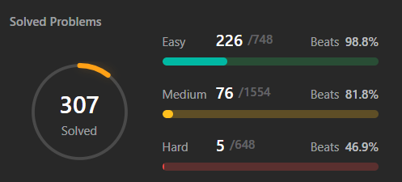
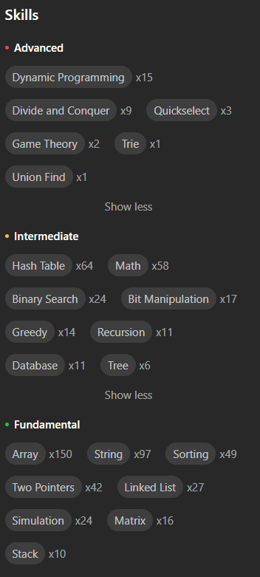
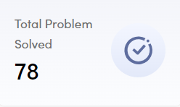
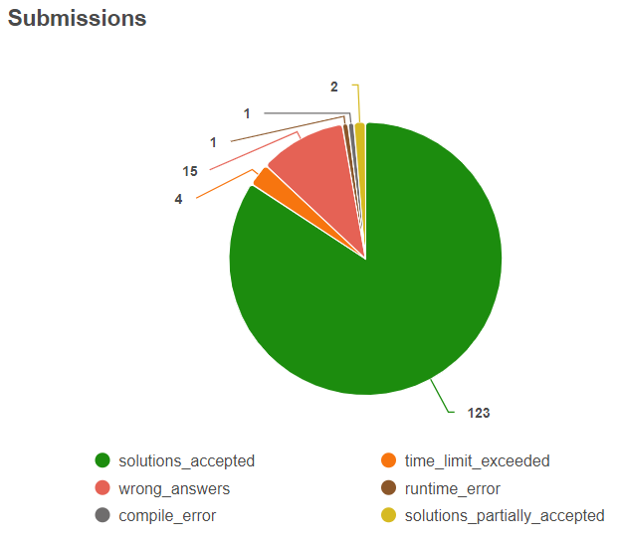
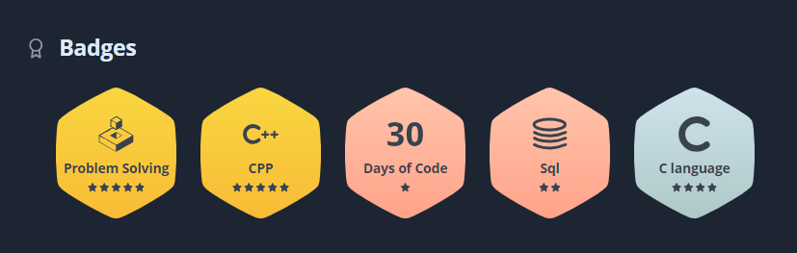
CODING SKILLS

Slide 5
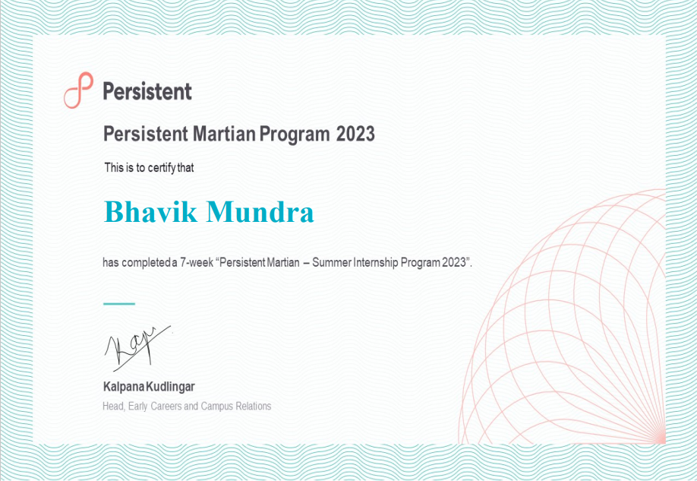
Persistent Martian Summer Training
As a Martian Intern at Persistent Systems, I honed my Python skills and gained practical insights into its professional applications. I acquired knowledge in Python, Data Structures, Algorithms, DBMS, and Linux.

Slide 6
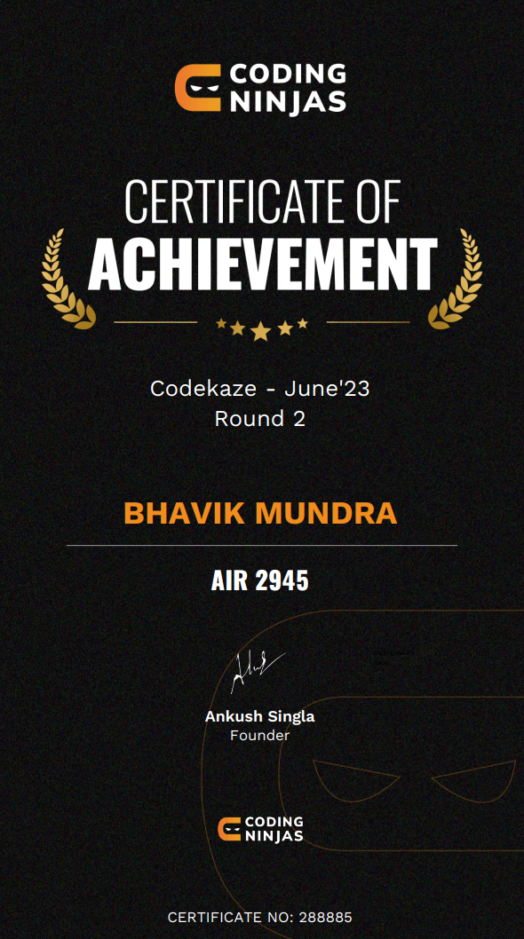
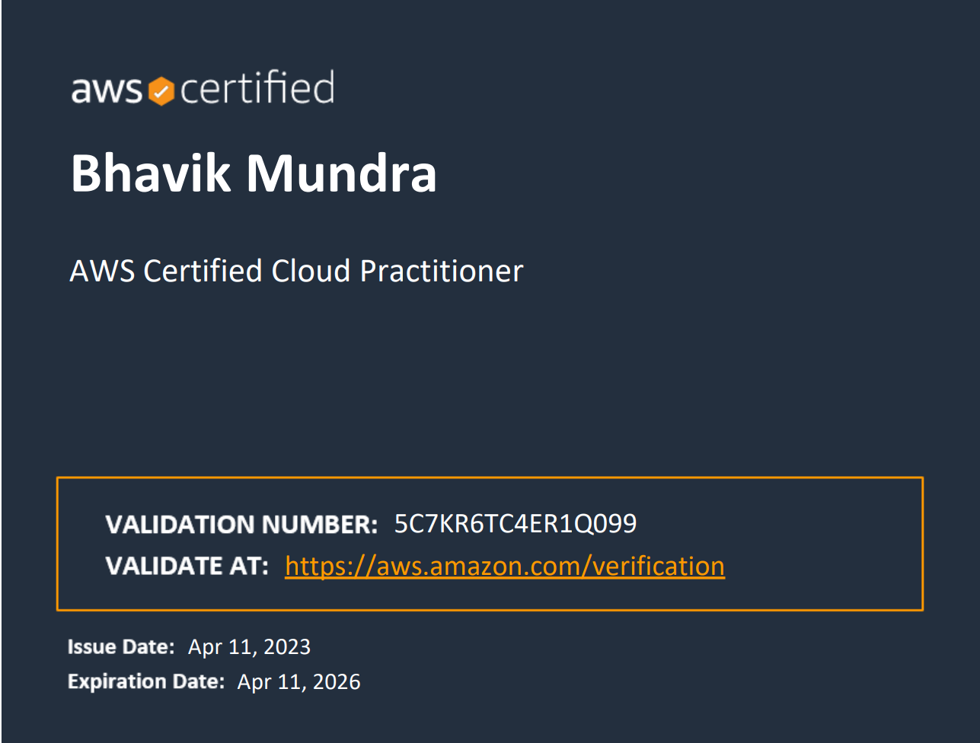
CERTIFICATES AND ACHIEVEMENTS
AWS Certified Cloud Practitioner Certification
TechGig CodeGladiator Semifinalist 2023.
CodeKaze 2023: All India Rank: 2945/1.37Lakh+ Participants, College Rank: 7.

Slide 7
Projects
Edith HTTP Web Server
House Rent Prediction Using ML and DL
Employee Management Application
Edith is an HTTP Web Server built using C and C++. It is a replica of Apache's Tomcat. Using this the user can build C++ based web applications.
A web application that predicts the rent of houses in Mumbai based on the house rent of nearby houses and the house condition seen in the images provided by the users using Deep Learning.
Data layer: Used to save data into files and databases which allows CRUD operations.
Business layer: Handling data in Data Structures to provide better speed for operations.
Presentation layer: GUI of the application to present data in an appropriate form.

Slide 8
Why I want to join HotWax?
I am excited about the prospect of contributing to HotWax Commerce and leveraging the opportunities it provides for personal and professional development. I believe HotWax is a great platform for continuous learning and skill development which is essential for my career growth.

Slide 9
Thank you
Bhavik Mundra
bhavik.mundra1603@gmail.com
+91-7049423348

